Slide 1







Objects and Associative Arrays
Objects, JSON, Associative Arrays, Maps and Sets
Objects, Maps, Sets
SoftUni Team
Technical Trainers
Software University
http://softuni.bg

Slide 2



Table of Contents
Objects and JSON
Access Keys And Values
Make Objects Read Only
Iterate Over Object Keys
The Map Class
The Set Class

Slide 3
Have a Question?
sli.do #JSCORE

Slide 4

Objects in JS
Objects, Properties and JSON

Slide 5
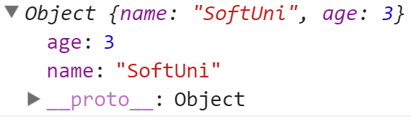
Objects in JS
Objects in JavaScript hold key-value pairs:
let obj = { name : "SoftUni", age : 3 };
console.log(obj); // Object {name: "SoftUni", age: 3}
obj['site'] = "https://softuni.bg";
obj.age = 10;
obj["name"] = "Software University";
console.log(obj); // Object {name: "Software University", age: 10, site: "https://softuni.bg"}
delete obj.name; // Delete a property
obj.site = undefined; // Delete a property value
console.log(obj); // Object {age: 10, site: undefined}

Slide 6
Object Keys and Values
let course = { name: 'JS Core', hall: 'Open Source' };
let keys = Object.keys(course);
console.log(keys); // [ 'name', 'hall' ]
if (course.hasOwnProperty('name'))
console.log(course.name); // JS Core
let values = Object.values(course);
console.log(values); // [ 'JS Core', 'Open Source' ]
if (values.includes('JS Core'))
console.log("Found 'JS Core' value");

Slide 7
Object Freeze and Seal
let cat = { name: 'Tom', age: 5 };
Object.freeze(cat);
cat.age = 10; // Error in strict mode
cat.gender = 'male'; // Error in strict mode
console.log(cat); // { name: 'Tom', age: 5 }
cat = { name: 'Tom', age: 5 };
Object.seal(cat);
cat.age = 10; // OK
delete cat.age; // Error in strict mode
console.log(cat); // { name: 'Tom', age: 10 }

Slide 8

Objects and JSON
JavaScript objects can be stored as text in JSON format
JSON == JavaScript Object Notation == text object format
let obj = { name : "SoftUni", age : 3 };
let str = JSON.stringify(obj);
console.log(str); // {"name":"SoftUni","age":3}
let str = "{\"name\":\"Nakov\",\"age\":24}"
let obj = JSON.parse(str);
console.log(obj); // Object {name: "Nakov", age: 24}

Slide 9
Problem: Towns to JSON
Read an array of strings, holding towns with GPS coordinates
Parse each string to JS object (see the below format)
Print the output array of objects as JSON string
| Town | Latitude | Longitude |
| Sofia | 42.696552 | 23.32601 |
| Beijing | 39.913818 | 116.363625 |
[{"Town":"Sofia","Latitude":42.696552,"Longitude":23.32601},{"Town":"Beijing","Latitude":39.913818,"Longitude":116.363625}]

Slide 10
Solution: Towns to JSON
function parseTownsToJSON(towns) {
let townsArr = [];
for (let town of towns.slice(1)) {
let [empty, townName, lat, lng] =
town.split(/\s*\|\s*/);
let townObj = { Town: townName, Latitude:
Number(lat), Longitude: Number(lng) };
townsArr.push(townObj);
}
return JSON.stringify(townsArr);
}
parseTownsToJSON(['|Town|Lat|Lng|', '|Sofia |42|23|'])
Check your solution here: https://judge.softuni.bg/Contests/315

Slide 11
Nested Objects in JS
let polygon = {
about: { name: "triangle", color: "red" },
corners: [{x:2, y:6}, {x:3, y:1}, {x:-2, y:2}]
};
console.log(JSON.stringify(polygon)); // {"about":{"name":"triangle","color":"red"},"corners":[{"x":2,"y":6},{"x":3,"y":1},{"x":-2,"y":2}]}
console.log(polygon.about.color); // red
polygon.about.location = {x:4, y:-7};

Slide 12
Problem: Score to HTML
Read a JSON string, holding array of objects: {name, score}
Print the objects as HTML table like shown below
[{"name":"Pesho & Kiro","score":479},{"name":"Gosho, Maria & Viki","score":205}]
<table>
<tr><th>name</th><th>score</th></tr>
<tr><td>Pesho &amp; Kiro</td><td>479</td></tr>
<tr><td>Gosho, Maria &amp; Viki</td><td>205</td></tr>
</table>

Slide 13
Solution: Score to HTML
function scoreToHTMLTable(scoreJSON) {
let html = "<table>\n";
html += " <tr><th>name</th><th>score</th>\n";
let arr = JSON.parse(scoreJSON);
for (let obj of arr)
html += ` <tr><td>${htmlEscape(obj['name'])}` +
`</td><td>${obj['score']}</td></tr>\n`;
return html + "</table>";
function htmlEscape(text) { // TODO … }
}
scoreToHTMLTable([{"name":"Pesho","score":70}])
Check your solution here: https://judge.softuni.bg/Contests/315

Slide 14
Iterating Over Object Values
let laptop = { RAM: '8GB', CPU: 'i7 2.20 GHz' };
for (let key in laptop) {
console.log(key); // RAM, CPU
console.log(laptop[key]); // 8GB, i7 2.20 GHz
}
for (let value of laptop) {
// TypeError: laptop is not iterable
}

Slide 15
Problem: From JSON to HTML Table
Read a JSON string, holding array of JS objects (key / value pairs)
Print the objects as HTML table like shown below
[{"Name":"Tomatoes & Chips","Price":2.35},{"Name":"J&B Chocolate","Price":0.96}]
<table>
<tr><th>Name</th><th>Price</th></tr>
<tr><td>Tomatoes &amp; Chips</td><td>2.35</td></tr>
<tr><td>J&amp;B Chocolate</td><td>0.96</td></tr>
</table>

Slide 16
Solution: From JSON to HTML Table
function JSONToHTMLTable(json) {
let html = "<table>\n";
let arr = JSON.parse(json);
html += " <tr>";
for (let key of Object.keys(arr[0]))
html += `<th>${htmlEscape(key)}</th>`;
html += "</tr>\n";
for (let obj of arr) {
// TODO: print obj values in <tr><td>…</td></tr>
return html + "</table>";
function htmlEscape(text) { // TODO … }
}
JSONToHTMLTable(['[{"X":5,"Y":7},{"X":2,"Y":4}]'])
Check your solution here: https://judge.softuni.bg/Contests/315

Slide 17
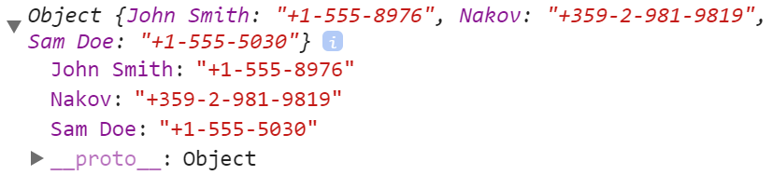


Associative Arrays
key
value
John Smith | +1-555-8976
Nakov | +359-2-981-9819
Sam Doe | +1-555-5030
Objects as Associative Arrays in JS

Slide 18
Associative Arrays (Maps, Dictionaries)
Associative arrays (maps / dictionaries) == arrays indexed by keys
Not by the numbers 0, 1, 2, …
Hold a set of pairs {key → value}, just like JS objects
Traditional array
Associative array (dictionary)
key
value
key
0 1 2 3 4
John Smith | +1-555-8976
Lisa Smith | +1-555-1234
Sam Doe | +1-555-5030
value
8 | -3 | 12 | 408 | 33

Slide 19
Phonebook – Associative Array Example
let phonebook = { };
phonebook["John Smith"] = "+1-555-8976"; // Add
phonebook["Lisa Smith"] = "+1-555-1234";
phonebook["Sam Doe"] = "+1-555-5030";
phonebook["Nakov"] = "+359-899-555-592";
phonebook["Nakov"] = "+359-2-981-9819"; // Replace
delete phonebook["John Smith"]; // Delete
console.log(Object.keys(phonebook).length); // 3
for (let key in phonebook) // Print
console.log(`${key} -> ${phonebook[key]}`);

Slide 20
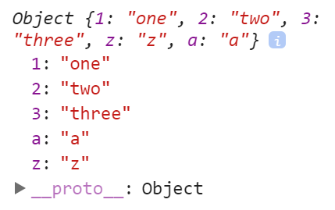
The Order of Keys in JS Object
The order of keys in JS objects is unspecified!
let obj = {
"1": 'one',
"3": 'three',
"2": 'two',
"z": 'z',
"a": 'a'
}
console.log(Object.keys(obj)); // ["1", "2", "3", "z", "a"]
console.log(obj); // Object {1: "one", 2: "two", 3: "three", z: "z", a: "a"}

Slide 21
Problem: Sum by Town
Read towns and incomes (like shown below) and print a JSON object holding the total income for each town (see below)
Sofia
20
Varna
3
Sofia
5
Varna
4
Print the towns in their natural order as object properties
{"Sofia":"25","Varna":"7"}

Slide 22
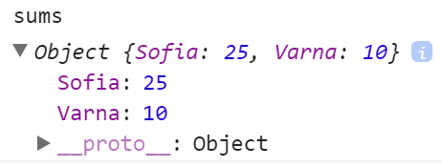
Solution: Sum of Towns
function sumOfTowns(arr) {
let sums = {};
for (let i=0; i<arr.length; i+=2) {
let [town, income] = [arr[i], Number(arr[i+1])];
if (sums[town] == undefined)
sums[town] = income;
else
sums[town] += income;
}
return JSON.stringify(sums);
}
sumOfTowns(['Sofia','20', 'Varna','10', 'Sofia','5'])
Check your solution here: https://judge.softuni.bg/Contests/315

Slide 23
Problem: Count Words in a Text
Write a JS function to count the words in a text (case sensitive)
Words are sequences of letters, digits and _
The input text comes as array of strings
Return the output as JSON string
JS devs use Node.js for server-side JS.
-- JS for devs
{"JS":3,"devs":2,"use":1,"Node":1,"js":1,"for":2,"server":1,"side":1}

Slide 24
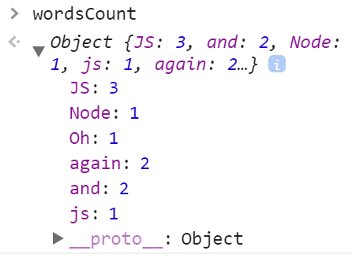
Solution: Count Words in a Text
function countWords(inputLines) {
let text = inputLines.join('\n');
let words = text.split(/[^A-Za-z0-9_]+/)
.filter(w => w != '');
let wordsCount = {};
for (let w of words)
wordsCount[w] ? wordsCount[w]++ :
wordsCount[w] = 1;
return JSON.stringify(wordsCount);
}
countWords(['JS and Node.js', 'JS again and again', 'Oh, JS?'])
Check your solution here: https://judge.softuni.bg/Contests/315

Slide 25

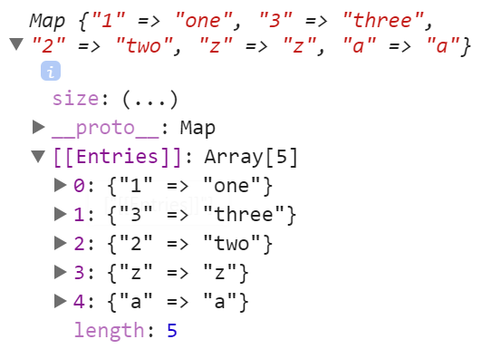
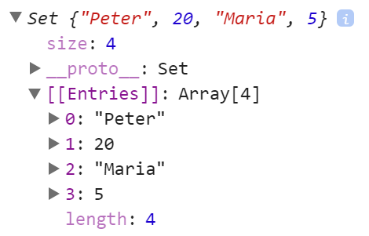
Practice: JS Objects & JSON
Live Exercises in Class (Lab)

Slide 26
The Map Class in JS
key
value
John Smith | +1-555-8976
Nakov | +359-2-981-9819
Sam Doe | +1-555-5030
Key / Value Map

Slide 27
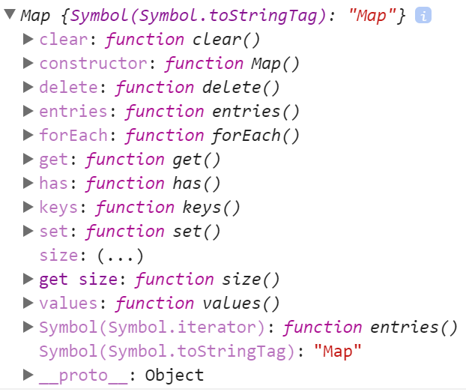
The Map Class in JS
The Map class holds { key → value } map
Better functionality than plain JS object
let score = new Map();
score.set("Peter", 130);
score.set("Maria", 85);
for (let [k, v] of score)
console.log(k + ' -> ' + v);

Slide 28
Phonebook – Map Example
let phonebook = new Map();
phonebook.set("John Smith", "+1-555-8976"); // Add
phonebook.set("Lisa Smith","+1-555-1234");
phonebook.set("Sam Doe", "+1-555-5030");
phonebook.set("Nakov", "+359-899-555-592");
phonebook.set("Nakov", "+359-2-981-9819"); // Replace
phonebook.delete("John Smith"); // Delete
console.log(phonebook.size); // 3
for (let [key, value] of phonebook) // Print
console.log(`${key} -> ${value}`);

Slide 29
Maps Preserve the Insertion Order of Keys
let map = new Map([
["1", 'one'],
["3", 'three'],
["2", 'two'],
["z", 'z'],
["a", 'a']
]);
console.log(map); // Map {"1" => "one", "3" => "three", "2" => "two", "z" => "z", "a" => "a"}
console.log(Array.from(map.keys()));
// ["1", "3", "2", "z", "a"]

Slide 30
Problem: Count Words in a Text (with Map)
Write a JS function to count the words in a text (case insensitive)
Words are sequences of letters, digits and _
The input comes as array of strings
Order alphabetically the output words
'devs' -> 3 times
'for' -> 2 times
'js' -> 6 times
'node' -> 1 times
'server' -> 1 times
'side' -> 1 times
'use' -> 2 times
JS devs use Node.js for server-side JS.
JS devs use JS.
-- JS for devs --

Slide 31
Solution: Count Words in a Text (with Map)
function countWords(inputLines) {
let words = inputLines.join('\n').toLowerCase()
.split(/[^A-Za-z0-9_]+/).filter(w => w != '');
let wordsCount = new Map();
for (let w of words)
wordsCount.has(w) ? wordsCount.set(w,
wordsCount.get(w)+1) : wordsCount.set(w, 1);
let allWords = Array.from(wordsCount.keys()).sort();
allWords.forEach(w =>
console.log(`'${w}' -> ${wordsCount.get(w)} times`));
}
countWords(['JS and Node.js', 'JS again and again', 'Oh, JS?'])
Check your solution here: https://judge.softuni.bg/Contests/315

Slide 32
Problem: Population in Towns
Read towns and population (like shown below) and print a the towns and their total population for each town (see below)
Print the towns in the order of their first appearance
Varna <-> 40000
Sofia <-> 1200000
Plovdiv <-> 20000
Sofia <-> 100000
Varna <-> 420000
Plovdiv <-> 400000
Plovdiv <-> 50000
Varna : 460000
Sofia : 1300000
Plovdiv : 470000

Slide 33
Solution: Population in Towns
function populationInTowns(dataRows) {
let total = new Map();
for (let dataRow of dataRows) {
let [town, population] = dataRow.split(/\s*<->\s*/);
population = Number(population);
if (total.has(town))
total.set(town, total.get(town) + population);
else total.set(town, population);
}
for (let [town, sum] of total)
console.log(town + " : " + sum);
}
populationInTowns(['B<->20', 'A<->30', 'B<->5'])
Check your solution here: https://judge.softuni.bg/Contests/315

Slide 34
Problem: City Markets
Read sales data in the following format
Print for each town the sum of incomes for each product
Order the towns and product as they first appear
{town} -> {product} -> {amountOfSales}:{priceForOneUnit}
Town - Sofia
$$$Laptops HP : 400000
$$$Raspberry : 300000000
$$$Audi Q7 : 20000000
Town - Montana
$$$Oranges : 200000
$$$Cherries : 4000
Sofia -> Laptops HP -> 200 : 2000
Sofia -> Raspberry -> 200000 : 1500
Montana -> Oranges -> 200000 : 1
Montana -> Cherries -> 1000 : 0.3
Sofia -> Audi Q7 -> 200 : 100000

Slide 35
Solution: City Markets (Nested Maps)
function cityMarkets(sales) {
let townsWithProducts = new Map();
for (let sale of sales) {
let [town, product, quantityPrice] = sale.split(/\s*->\s*/);
let [quantity, price] = quantityPrice.split(/\s*:\s*/);
if (!townsWithProducts.has(town))
townsWithProducts.set(town, new Map());
let income = quantity * price;
let oldIncome = townsWithProducts.get(town).get(product);
if (oldIncome) income += oldIncome;
townsWithProducts.get(town).set(product, income);
}
// TODO: print the incomes by towns and products
}
Check your solution here: https://judge.softuni.bg/Contests/315

Slide 36
The Set Class in JS
Set of Unique Values of Any Type

Slide 37
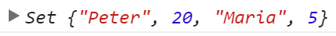
The Set Class in JS
Sets in JS are collections of unique objects
The insertion order is preserved, with no duplicates
let names = new Set();
names.add("Peter"); names.add(20);
names.add("Maria"); names.add(5);
console.log(names.has('Peter')); // true
names.add("Maria"); // Duplicates are skipped
names.delete(20); // Delete element if exists
for (let name of names) console.log(name);

Slide 38
Problem: Extract Unique Words
Write a JS function to extract all unique words from a text (case insensitive)
Words are sequences of letters, digits and _
The input comes as array of strings
The output should hold the words in their order of appearance
JS devs use Node.js for server-side JS.
JS devs use JS.
-- JS for devs --
js, devs, use, node, for, server, side

Slide 39
Solution: Extract Unique Words
function extractWords(inputSentences) {
let wordPattern = /\b[a-zA-Z0-9_]+\b/g;
let words = new Set();
for (let sentence of inputSentences) {
let matches = sentence.match(wordPattern);
matches.forEach(x=>words.add(x.toLowerCase()));
}
console.log([...words.values()].join(", "));
}
extractWords(['JS and Node.js', 'JS again and again', 'Oh, JS?'])
Check your solution here: https://judge.softuni.bg/Contests/315

Slide 40
Practice: Using Maps and Sets
Live Exercises in Class (Lab)

Slide 41

Summary
Objects in JS hold key-value pairs
Maps map keys to values, preserve keys order
Sets hold unique collection of values
let obj = { name : "SoftUni", age : 3 };
obj.age++;
obj[town] = 'Sofia';
delete obj.name;
let map = new Map();
map.set('score', 20);
let map = new Set(); set.add(5);

Slide 42







Objects and Associative Arrays
https://softuni.bg/courses/

Slide 43
License
This course (slides, examples, demos, videos, homework, etc.) is licensed under the "Creative Commons Attribution-NonCommercial-ShareAlike 4.0 International" license

Slide 44





Free Trainings @ Software University
Software University Foundation – softuni.org
Software University – High-Quality Education, Profession and Job for Software Developers
softuni.bg
Software University @ Facebook
facebook.com/SoftwareUniversity
Software University Forums
forum.softuni.bg

